Slide 1
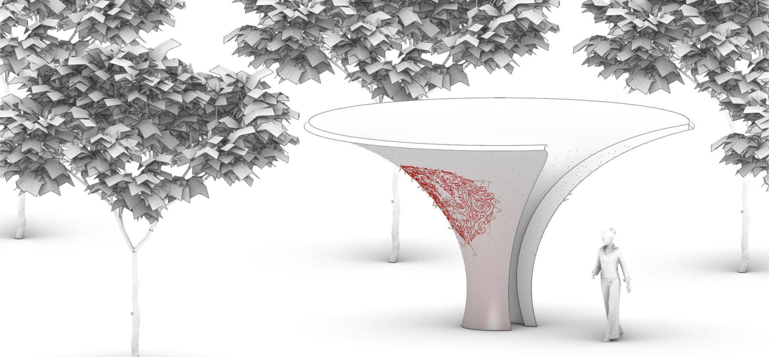
Path planning for surface filling extrusions
Design tool for surface filling extrusions from local human input
Merlin Bieling
Munich, June 3rd 2025

Slide 2
Agenda
Introduction
State of the Art
Objective
Method
Implementation
Next steps
Notes:
- OUTLINE - GUIDING PAPERS – FUNCTIONALITY&REQUIREMENTS – SFC BY MEDIAL AXIS - CODE DEVELOPED SO FAR – MY PLANS

Slide 3
Introduction
Notes:
The topic of the proposed project is path planning for surface filling extrusions.
The goal is to develop a design tool, which aids in the generation of path plans from local human input.
The primary application is the fabrication of stylized surface finishes, either through material extrusion or spraying of material for example shotcrete 3d printing.

Slide 4
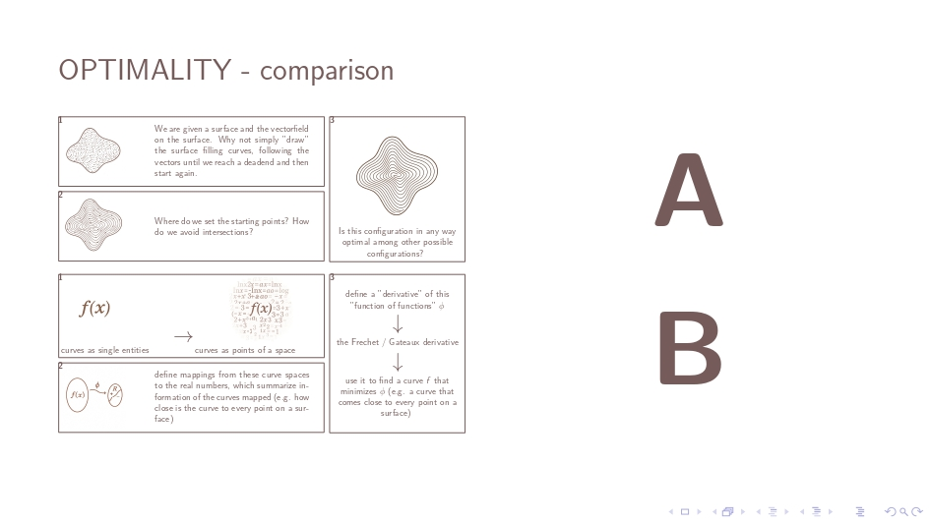
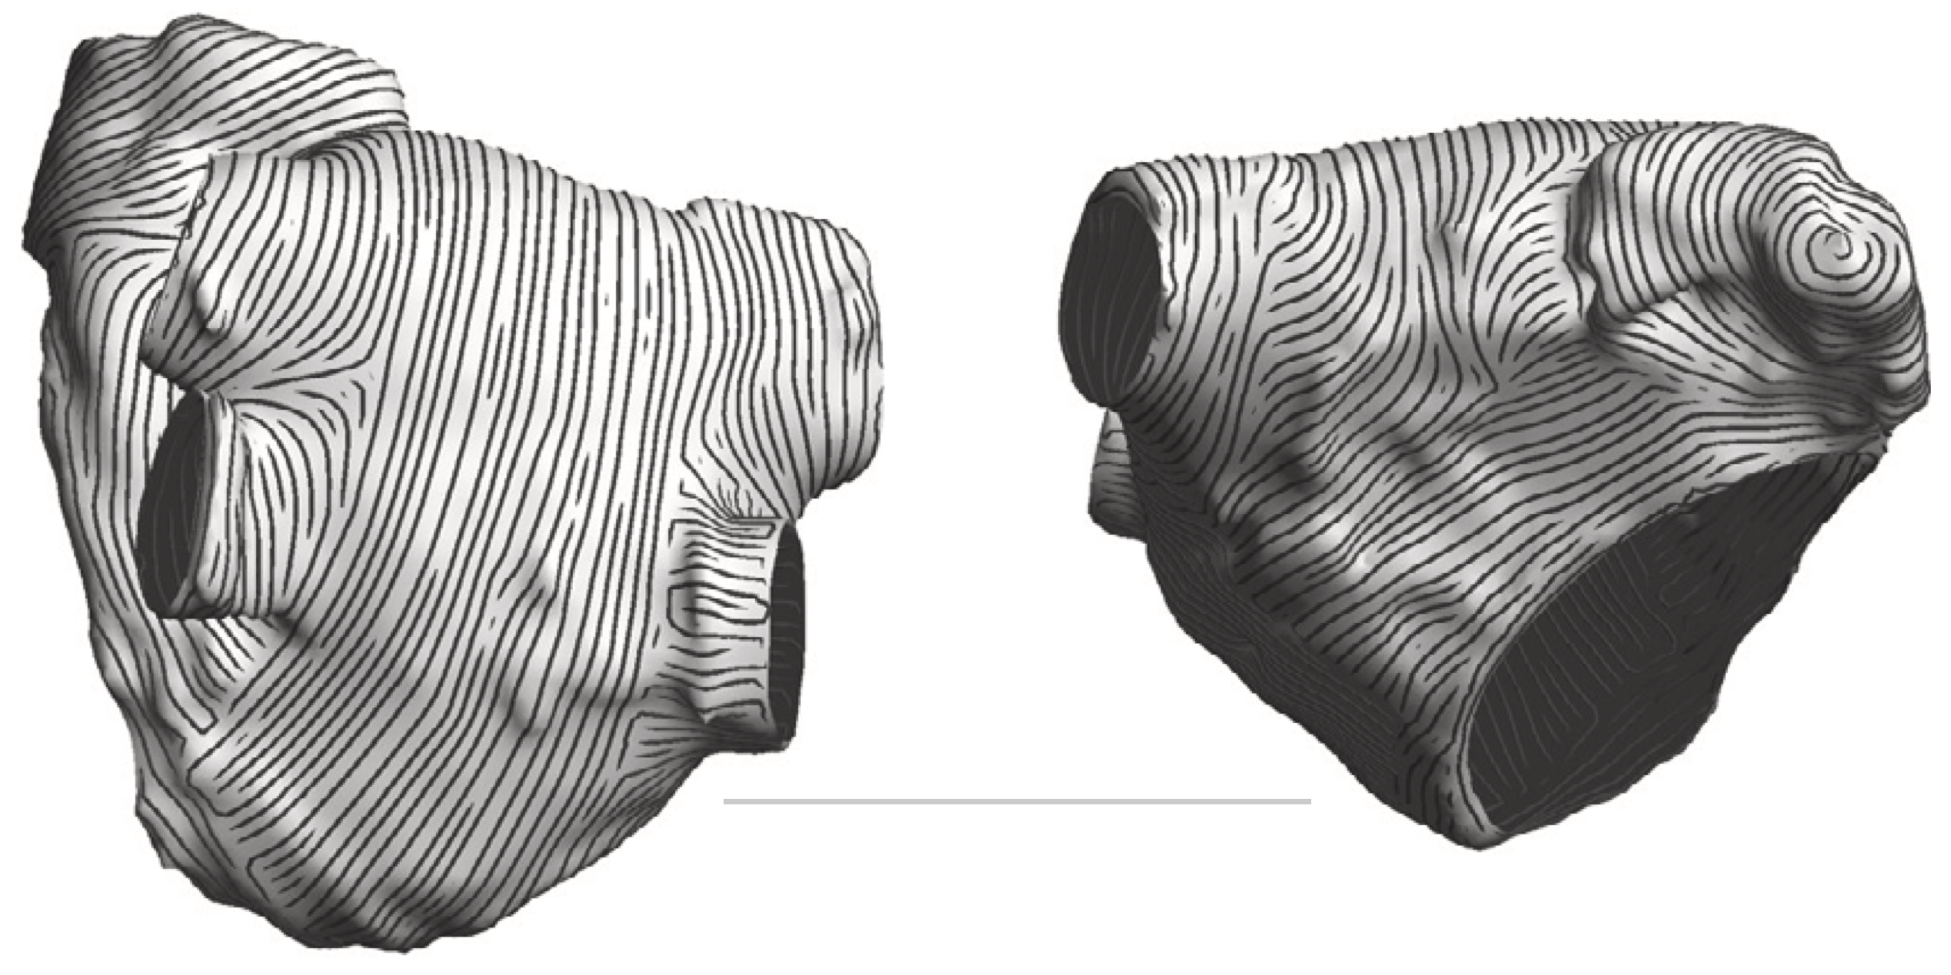
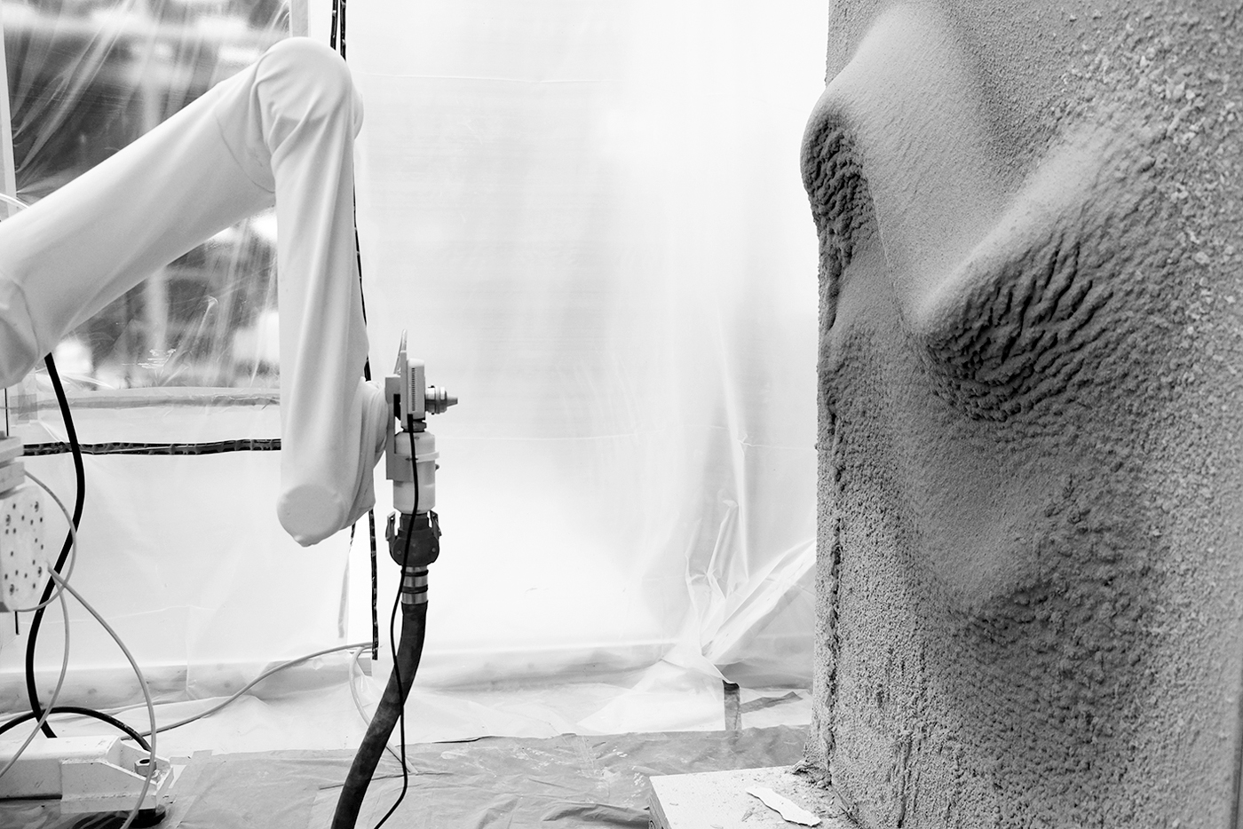
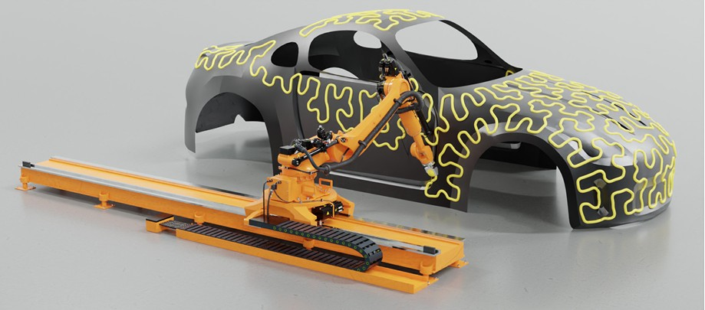
State of the Art
Computational Design Tools:
“Improved algorithm for generating evenly-spaced streamlines from an orientation field on a triangulated surface“, Jacquemet et al. (2024)
“Surface-Filling Curve Flows via Implicit Medial Axes“, Noma et al. (2024)
Additive Manufacturing in Construction:
“Robotic on‑site adaptive thin‑layer printing: Challenges and workflow for design and fabrication of bespoke cementitious plasterwork at full architectural scale”, Selen et al. (2022)
Notes:
REPRES…A&B - MAIN PAPER INFORMING ME: SELEN ERCAN

Slide 5
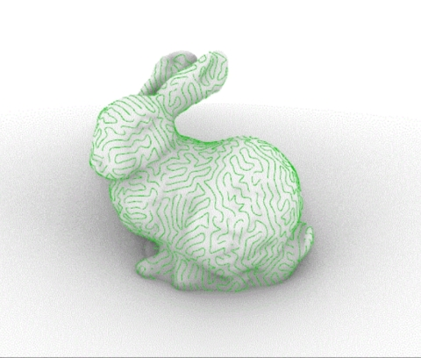
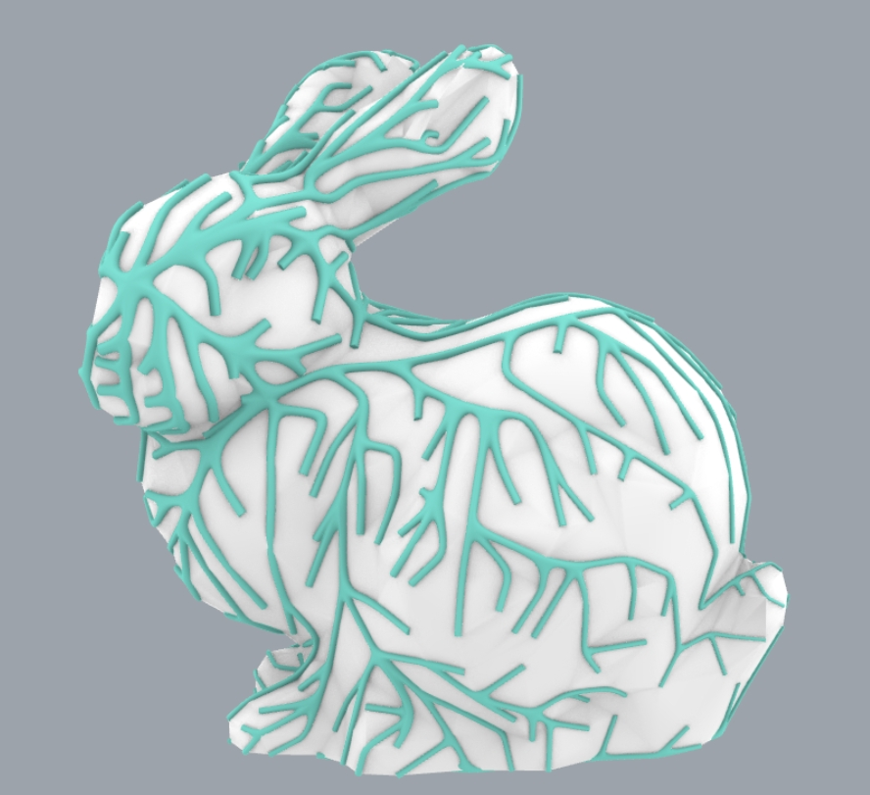
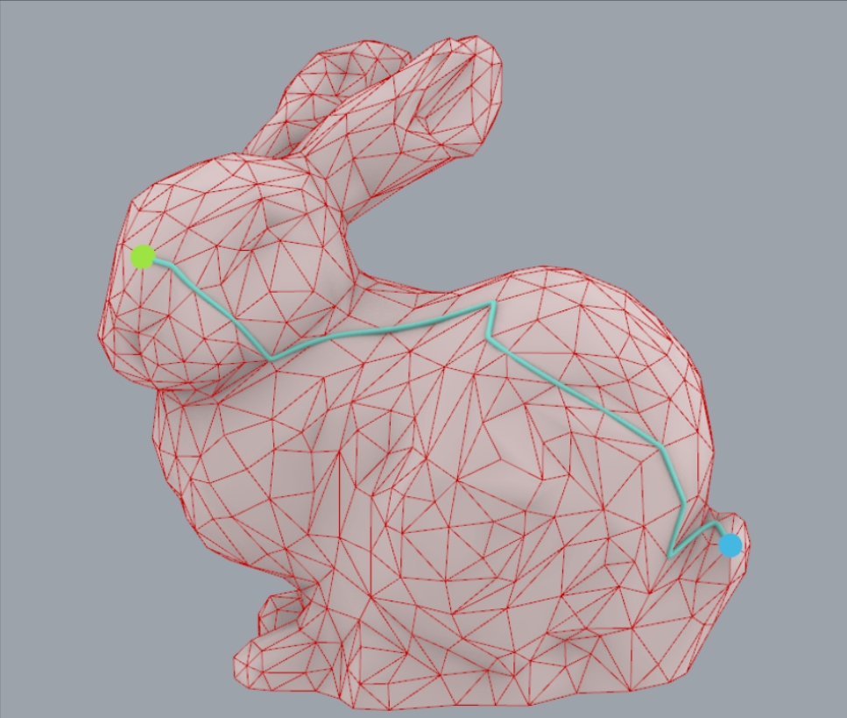
State of the Art - Deadfish
Main capabilities:
Differential Growth
Orthogonal Branching System
Dijkstra (shortest edge path between vertices)
Theory (probably):
Differential growth algorithms often use random seed generation (see “Differential Growth”, Bakker et al. (2022))
Credit: Chenming He
Notes:
FORWARDED…

Slide 6
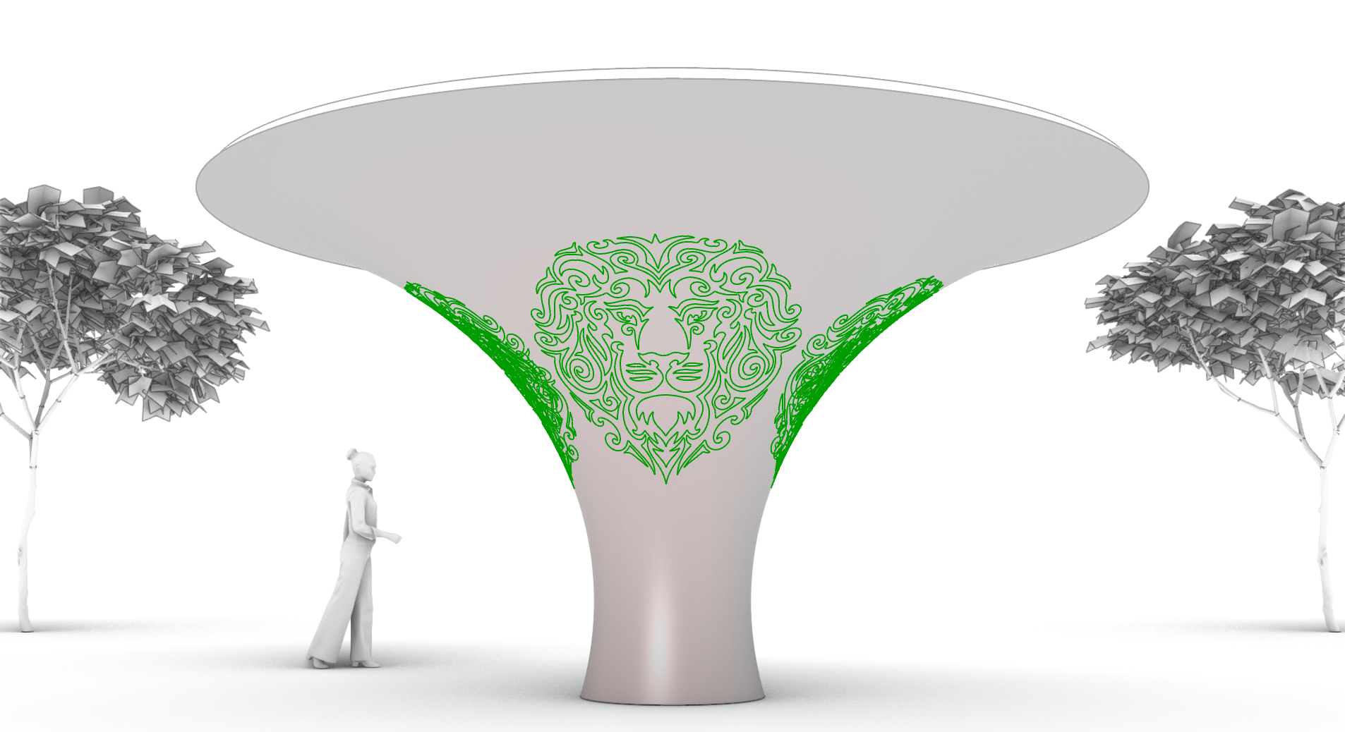
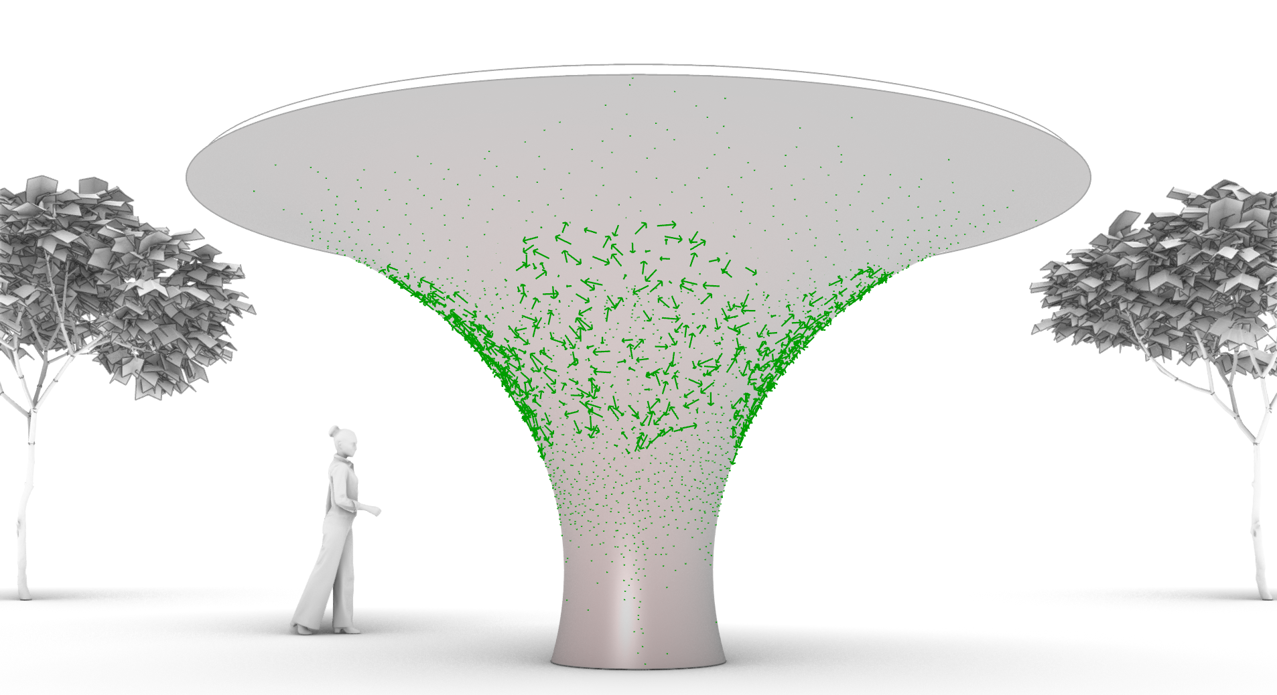
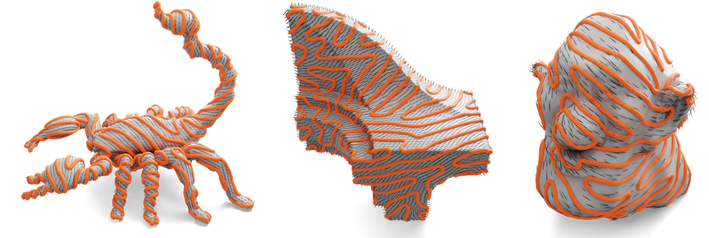
Objective
Given the surface and curves (human input) on that surface…
…it will generate a continuous tangent vector field, an orientation field from the curves…
… to fill that surface according to the orientation field with extrusions…
… while making it additively manufacturable with mobile robotic 3d printing.
Credit: Noma

Slide 7
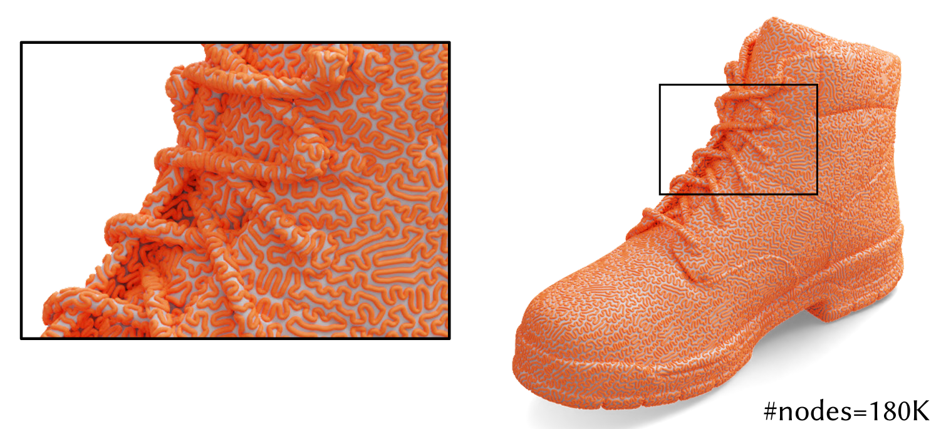
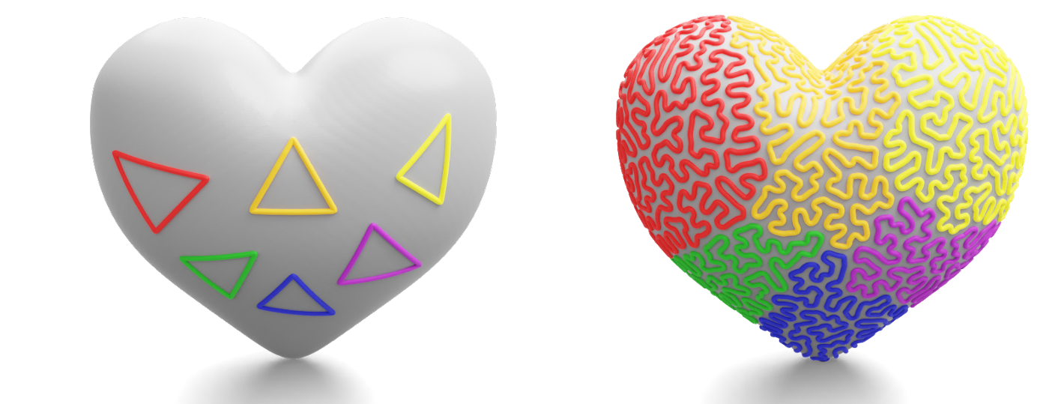
Objective
Physical requirements:
Cover of entire surface to increase durability of surface finish
Avoid self intersection to increase adhesion and ressource efficiency
Additive manufacturing requirements:
Stationary printing imposes restricted working area
„Wet-on-Wet“ application of hydraulic cements requires time efficiency
In some setups: only continouus printing is possible
Credit: Noma
Credit: Noma
Notes:
COVER – SELF INTERSECTION ----- RESTRICTED WORKING AREA – HYDRAULIC CEMENTS

Slide 8
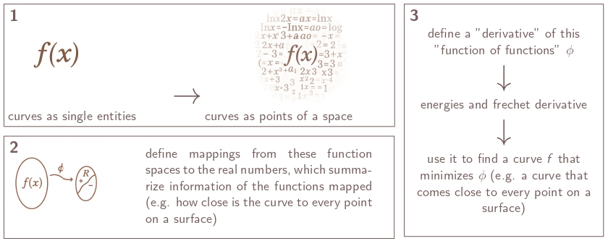
Method
Reimplementation of “Surface-Filling Curve Flows via Implicit Medial Axes“

Slide 9
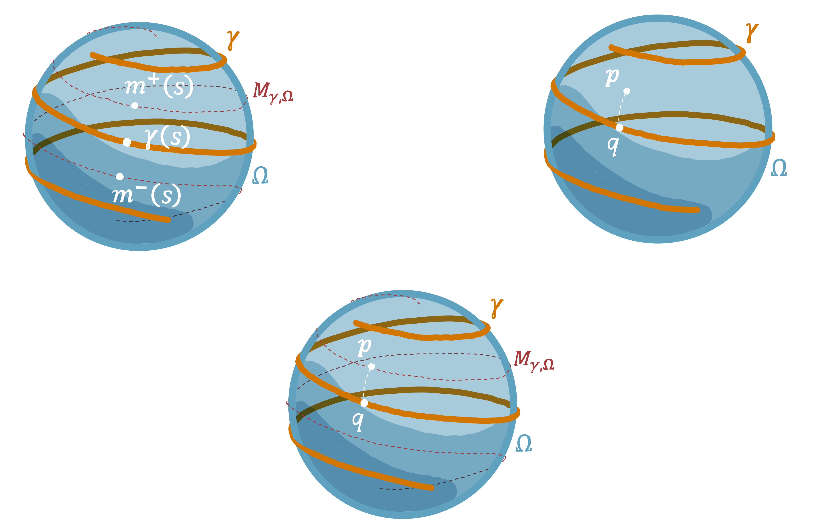
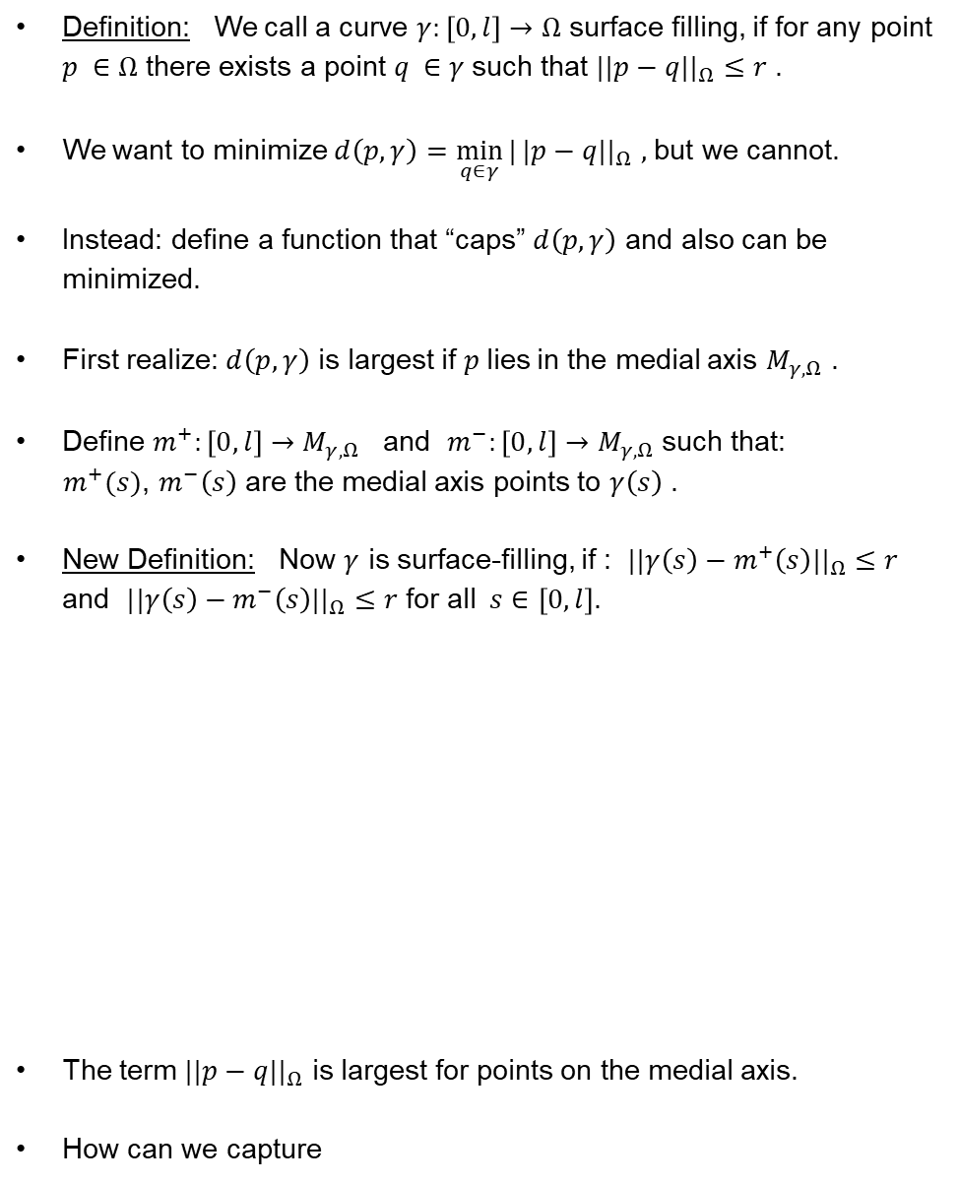
Method
Definition: We call a curve $γ:\left[0,l\right]→Ω$ surface filling, if for any point $p ∈Ω$ there exists a point $q ∈γ$such that $||p−q{||}_{Ω}≤r$ .
We want to minimize $d\left(p,γ\right)=\min_{q∈γ}{|}|p−q{||}_{Ω}$ $,$but we cannot.
Instead: define a function that “caps” $d\left(p,γ\right)$ and also can be minimized.
First realize: $d\left(p,γ\right)$ is largest if $p$lies in the medial axis $M_{γ,Ω}$ .
Define $m^{+}:\left[0,l\right]→M_{γ,Ω}$ and $m^{−}:\left[0,l\right]→M_{γ,Ω}$ such that:
$m^{+}(s)$, $m^{−}\left(s\right)$ are the medial axis points to $γ\left(s\right)$ .
New Definition: Now $γ$ is surface-filling, if : $||γ\left(s\right)−m^{+}\left(s\right){||}_{Ω}≤r$ and $||γ\left(s\right)−m^{−}\left(s\right){||}_{Ω}≤r$ for all $s∈\left[0,l\right]$.
The term $||p−q{||}_{Ω}$ is largest for points on the medial axis.
How can we capture
Notes:
Definition. Omega. P,q. geodetic distance. r.
In analysis we generate functions and we minimize them.
For the curve to be covering DENSELY…. Largest. P in medial axis.
Two questions: how can we

Slide 10
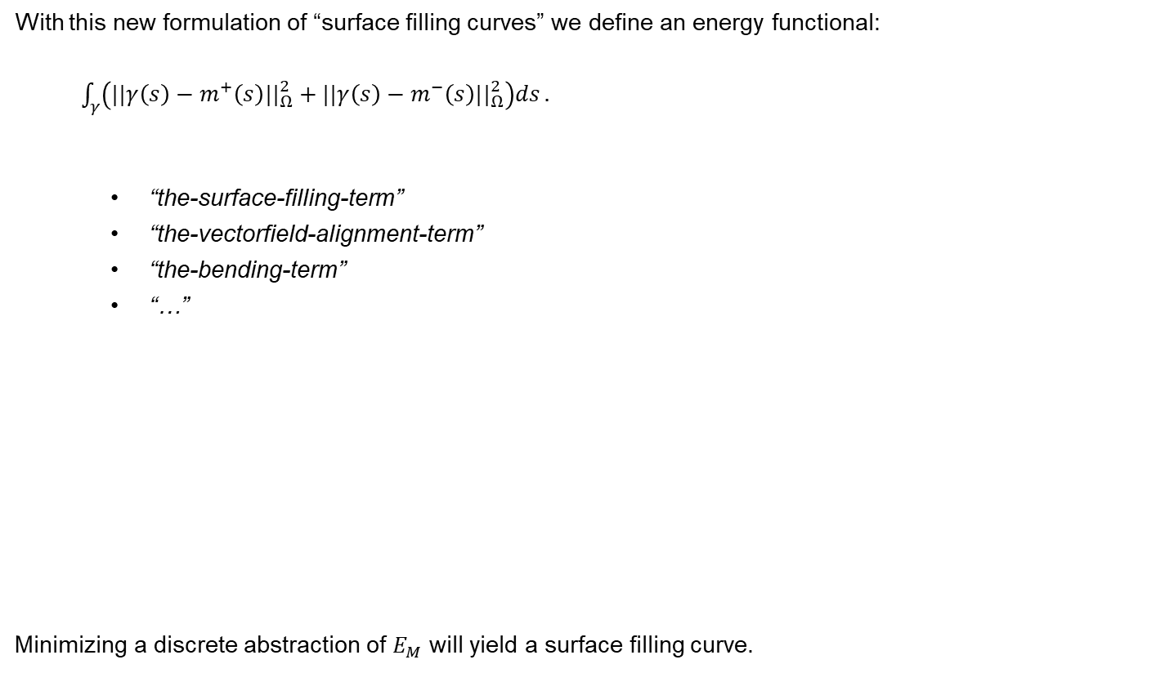
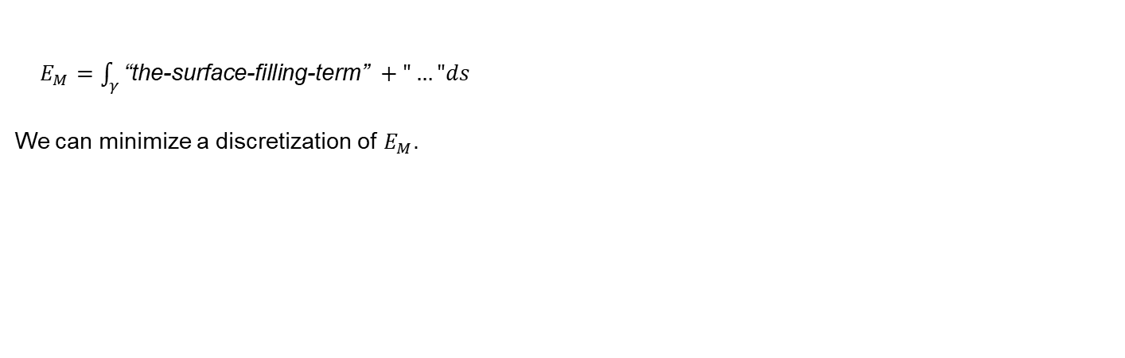
Method
With this new formulation of “surface filling curves” we define an energy functional:
$\int_{γ}{\left(||γ\left(s\right)−m^{+}\left(s\right){||}_{Ω}^{2}+||γ\left(s\right)−m^{−}\left(s\right){||}_{Ω}^{2}\right)ds}.$
“the-surface-filling-term”
“the-vectorfield-alignment-term”
“the-bending-term”
“…”
Minimizing a discrete abstraction of $E_{M}$ will yield a surface filling curve.
“If the integral goes to zero,
then so must the integrand.”
$E_{M}=\int_{γ}{\text{“}\text{the}\text{−}\text{surface}\text{−}\text{filling}\text{−}\text{term}\text{” }+"…"ds}$
We can minimize a discretization of $E_{M}$.
Notes:
Definition. Omega. P,q. geodetic distance. r.
In analysis we generate functions and we minimize them.
For the curve to be covering DENSELY…. Largest. P in medial axis.
Two questions: how can we

Slide 11
Implementation

Slide 12
Next Steps
Until Mid-Term-Two, July 8th 2025: Finishing to implement “sfc-by-medial-axis” algorithm

Slide 13
Basis of the Master Slides
The TUM Corporate Design Style Guide serves as the basis.
The presentation template is optimized for good readability and clear presentation of information.

Slide 15
Here is a Headline max. 2 lines
The TUM Corporate Design Style Guide serves as the basis.
The presentation template is optimized for good readability and clear presentation of information.

Slide 16
Schrift
The basic principle is to convey information in the best possible way. Above all, the font must be uniform and legible for everyone in the room.
Font: Arial Font sizes: 25 | 18 | 14 | 11 Line spacing: 1.15mm
The settings are set as default in the text fields and text field templates of this ppt master. For charts and tables, the font size may need to be adjusted. For markups in the body text, bold can also be marked. If the distance is large or the presentation medium is small, the font size can be increased proportionally if necessary.

Slide 17
Colours
The first thing to do is to work with black and white. For more elaborate representations, colors should be used wisely and to the smallest possible extent. In this slide master, the color palette is fixed.
Work with the primary colors first.
For e.g. complex diagrams, secondary colors are still available.
The accent colors are not used much.

Slide 18
Text
Short and concise texts, continuous texts aligned to the left, no justification
Example: Tem soluptam, nisi as verum ereprehendam at acculpa quidisq uissit volupta tusdant utem as etur, odi odis es doluptiae dem nimaion con nossinctenis pora quam voloria consenimus blabore everfer epeliquo maio etur.

Slide 19
Images - General
Simple presentation of information
Reduced colors
Avoid frames and overlays if possible

Slide 20
Enumeration
For small bulleted lists, do without bullet points and, if necessary, add an additional blank line Only mention the essential points and split topics on different pages.
Point 1
Point 2
If sub-items are necessary in a bulleted list, it is possible to indent with –
Point 1
Subpoint 1
Subpoint 2
For larger lists, use the default setting •
Point 1
Subpoint 2

Slide 21
Pictures
Description upper edge of the image: boundaries by text

Slide 22
Pictures
Heading 2 Here is an introductory or descriptive continuous text and, if desired, a lis
Point 1
Point 2
Point 3
Point 4

Slide 23
Pictures
Description upper edge of the image: boundaries by text

Slide 24
Pictures
Description upper edge of the image: boundaries by page

Slide 25
Image format filling - maximum image size

Slide 26
Non-format filling images
Alternatively with format-filling background: 5% black Labels can also be attached next to the pictures
Image explanation

Slide 27
Table – Example 1
Ø - Distance | 39 km/day (14,360 km/year)
Ø - Velocity | 25 km/h
Ø - Available charging time | 22 h/day
Cost | Small car with combustion engine
Application | City and surrounding area
Table without color and no border inner margin left 0 cm, top e.g. 0.5 cm (for enough line spacing inside)

Slide 28
Table – Example 2
Table with black border inner margin on the left 0.15 cm, e.g. 0.5 cm on the top (for enough line spacing inside)
Ø - Stretch | 39 km/day (14,360 km/year)
Ø - Speed | 25 km/h
Ø - Available charging time | 22 h/day
Cost | Small car with combustion engine
Application | City and surrounding area

Slide 29
Diagrams – Example 1
If possible, stay left-aligned Avoid unnecessary strokes and bars

Slide 30
Diagrams

